Slide 1
Announcements
Midterm 2 prep page is up
Material covered
Extra office hours
Past exams + solutions
Practice midterm 2
Optional
1 point of EC for completing

Slide 2
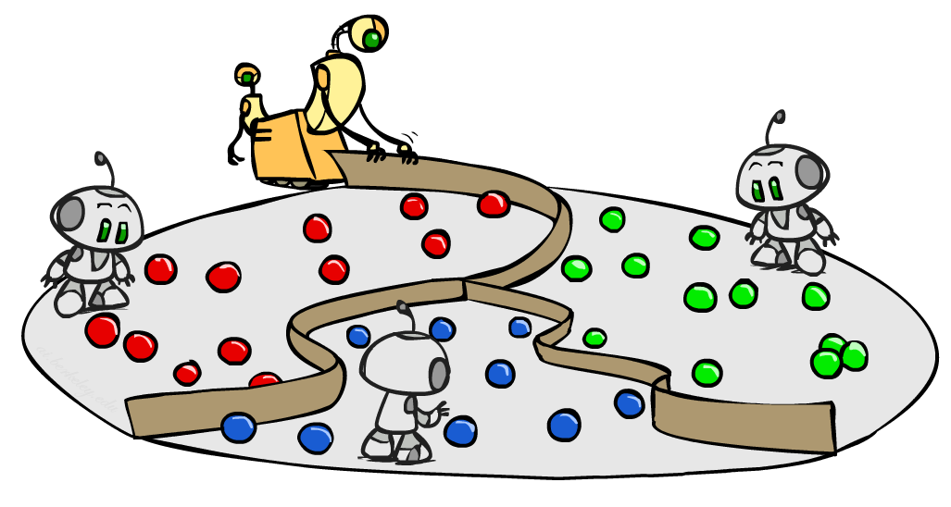
CS 188: Artificial Intelligence
Kernels and Clustering
Instructors: Dan Klein and Pieter Abbeel --- University of California, Berkeley
[These slides were created by Dan Klein and Pieter Abbeel for CS188 Intro to AI at UC Berkeley. All CS188 materials are available at http://ai.berkeley.edu.]
Notes:
Please retain proper attribution, including the reference to ai.berkeley.edu. Thanks!

Slide 3
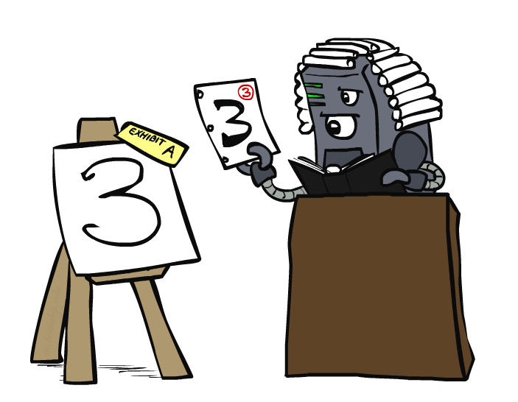
Case-Based Learning

Slide 4
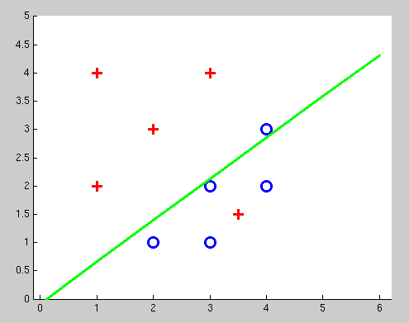
Non-Separable Data

Slide 5
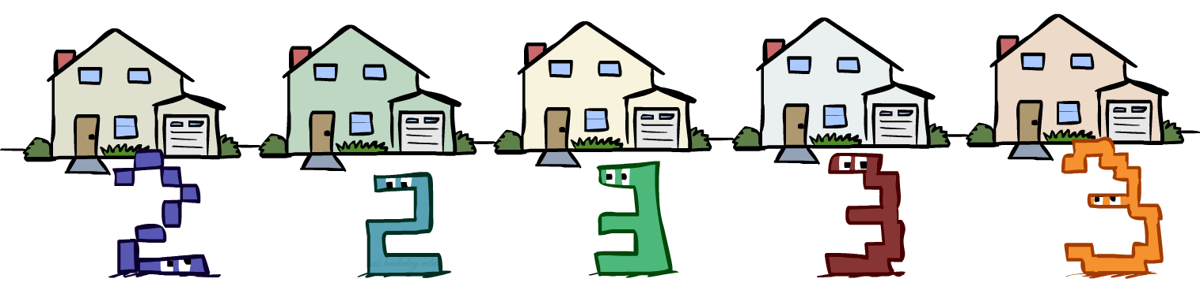
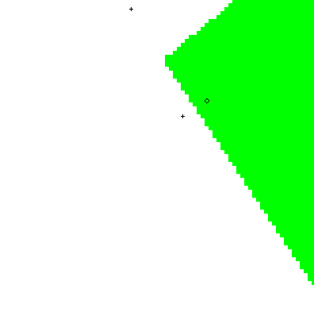
Case-Based Reasoning
Classification from similarity
Case-based reasoning
Predict an instance’s label using similar instances
Nearest-neighbor classification
1-NN: copy the label of the most similar data point
K-NN: vote the k nearest neighbors (need a weighting scheme)
Key issue: how to define similarity
Trade-offs: Small k gives relevant neighbors, Large k gives smoother functions
http://www.cs.cmu.edu/~zhuxj/courseproject/knndemo/KNN.html

Slide 6
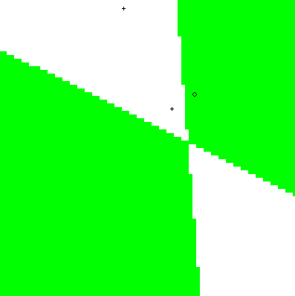

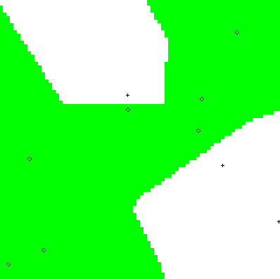
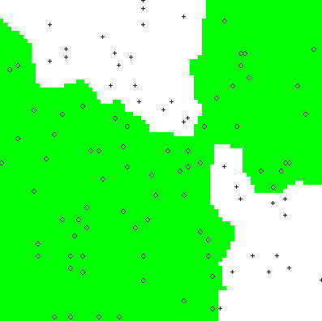
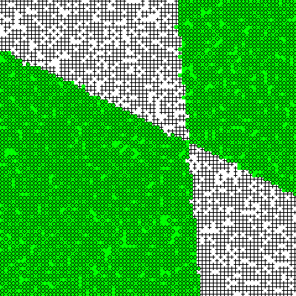
Parametric / Non-Parametric
Parametric models:
Fixed set of parameters
More data means better settings
Non-parametric models:
Complexity of the classifier increases with data
Better in the limit, often worse in the non-limit
(K)NN is non-parametric
Truth
2 Examples
10 Examples
100 Examples
10000 Examples

Slide 7





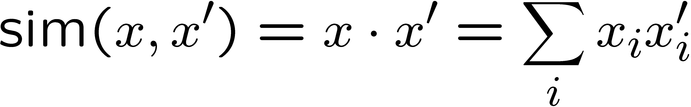


Nearest-Neighbor Classification
Nearest neighbor for digits:
Take new image
Compare to all training images
Assign based on closest example
Encoding: image is vector of intensities:
What’s the similarity function?
Dot product of two images vectors?
Usually normalize vectors so ||x|| = 1
min = 0 (when?), max = 1 (when?)
0
1
2
0
1
2

Slide 8
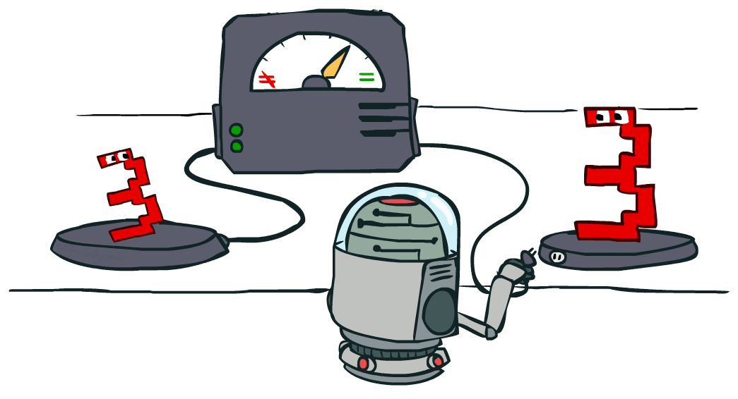
Similarity Functions

Slide 9
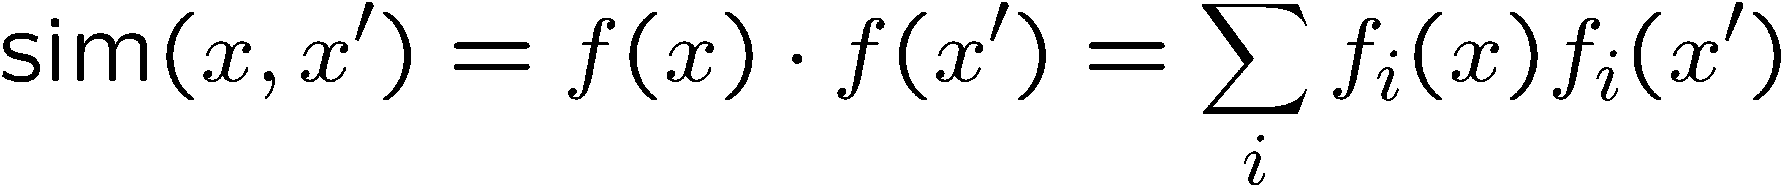
Basic Similarity
Many similarities based on feature dot products:
If features are just the pixels:
Note: not all similarities are of this form

Slide 10


Invariant Metrics
Better similarity functions use knowledge about vision
Example: invariant metrics:
Similarities are invariant under certain transformations
Rotation, scaling, translation, stroke-thickness…
E.g:
16 x 16 = 256 pixels; a point in 256-dim space
These points have small similarity in R²⁵⁶ (why?)
How can we incorporate such invariances into our similarities?
This and next few slides adapted from Xiao Hu, UIUC

Slide 11


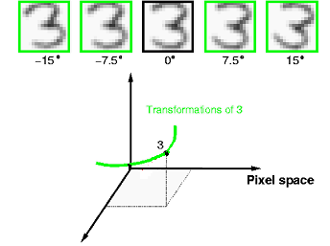
Rotation Invariant Metrics
Each example is now a curve in R²⁵⁶
Rotation invariant similarity:
s’=max s( r( ), r( ))
E.g. highest similarity between images’ rotation lines

Slide 12
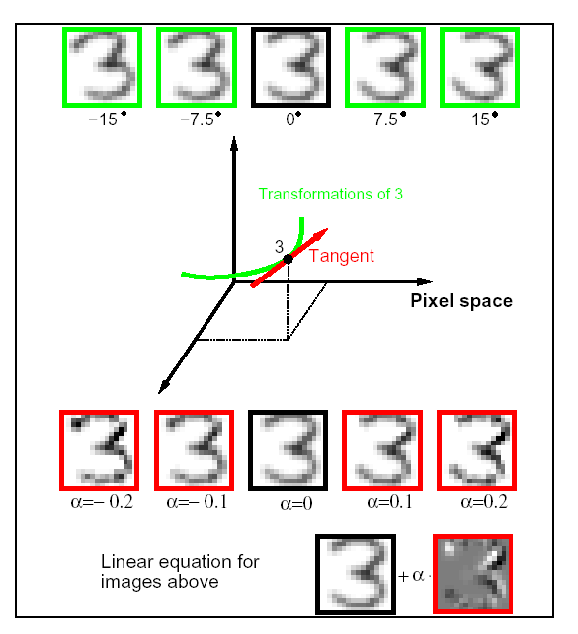
Tangent Families
Problems with s’:
Hard to compute
Allows large transformations (e.g. 6 → 9)
Tangent distance:
1st order approximation at original points.
Easy to compute
Models small rotations

Slide 13
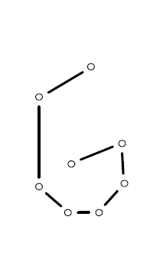
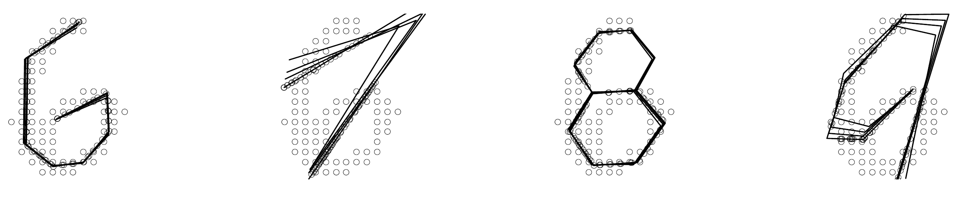
Template Deformation
Deformable templates:
An “ideal” version of each category
Best-fit to image using min variance
Cost for high distortion of template
Cost for image points being far from distorted template
Used in many commercial digit recognizers
Examples from [Hastie 94]

Slide 14
A Tale of Two Approaches…
Nearest neighbor-like approaches
Can use fancy similarity functions
Don’t actually get to do explicit learning
Perceptron-like approaches
Explicit training to reduce empirical error
Can’t use fancy similarity, only linear
Or can they? Let’s find out!

Slide 15
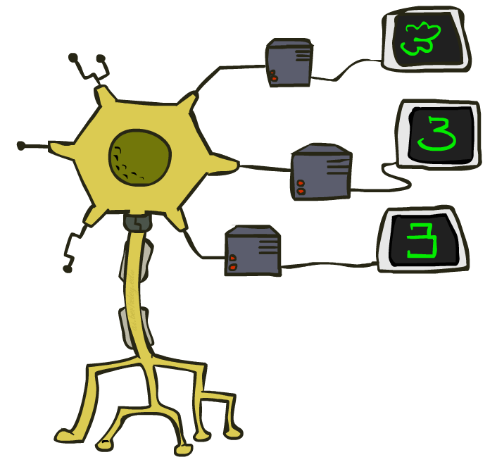
Kernelization

Slide 16
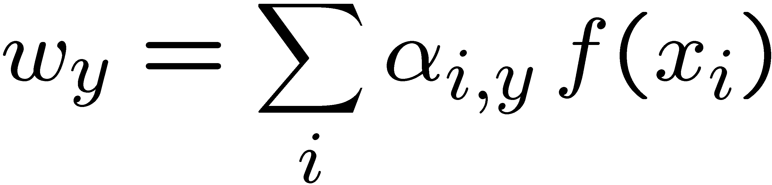
Perceptron Weights
What is the final value of a weight w_{y} of a perceptron?
Can it be any real vector?
No! It’s built by adding up inputs.
Can reconstruct weight vectors (the primal representation) from update counts (the dual representation)

Slide 17
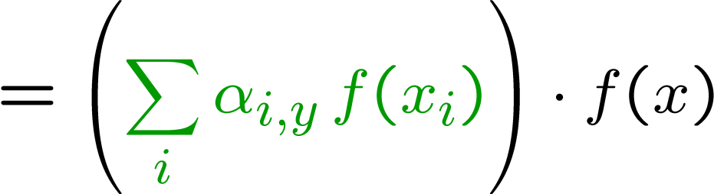
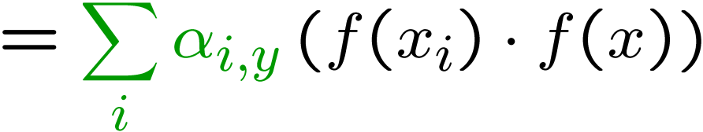
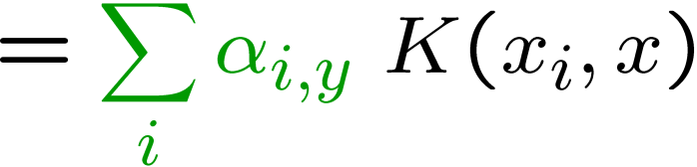
Dual Perceptron
How to classify a new example x?
If someone tells us the value of K for each pair of examples, never need to build the weight vectors (or the feature vectors)!

Slide 18
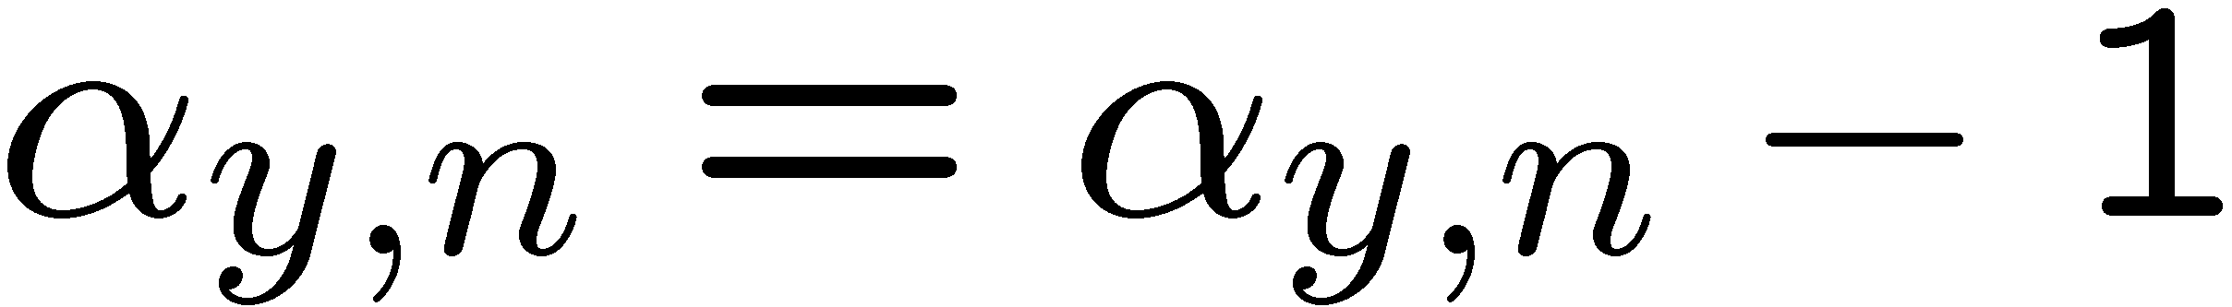
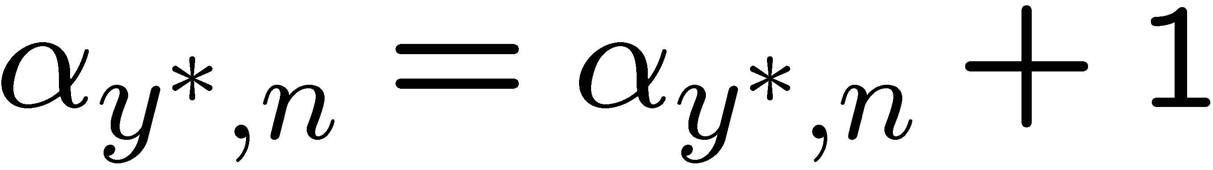
Dual Perceptron
Start with zero counts (alpha)
Pick up training instances one by one
Try to classify x_{n},
If correct, no change!
If wrong: lower count of wrong class (for this instance), raise count of right class (for this instance)

Slide 19

Kernelized Perceptron
If we had a black box (kernel) K that told us the dot product of two examples x and x’:
Could work entirely with the dual representation
No need to ever take dot products (“kernel trick”)
Like nearest neighbor – work with black-box similarities
Downside: slow if many examples get nonzero alpha

Slide 20
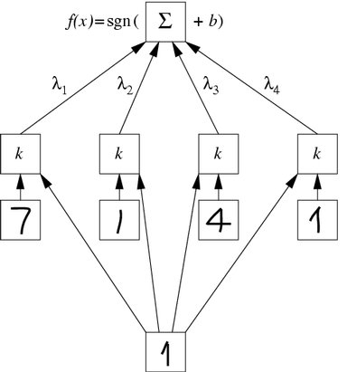
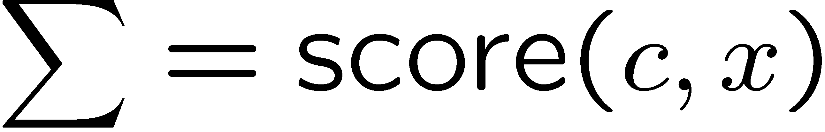
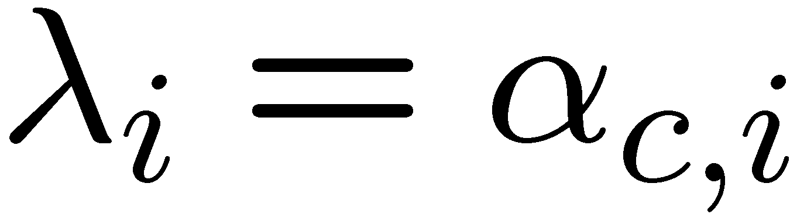
Kernelized Perceptron Structure

Slide 21
Kernels: Who Cares?
So far: a very strange way of doing a very simple calculation
“Kernel trick”: we can substitute any* similarity function in place of the dot product
Lets us learn new kinds of hypotheses
* Fine print: if your kernel doesn’t satisfy certain technical requirements, lots of proofs break. E.g. convergence, mistake bounds. In practice, illegal kernels sometimes work (but not always).

Slide 22
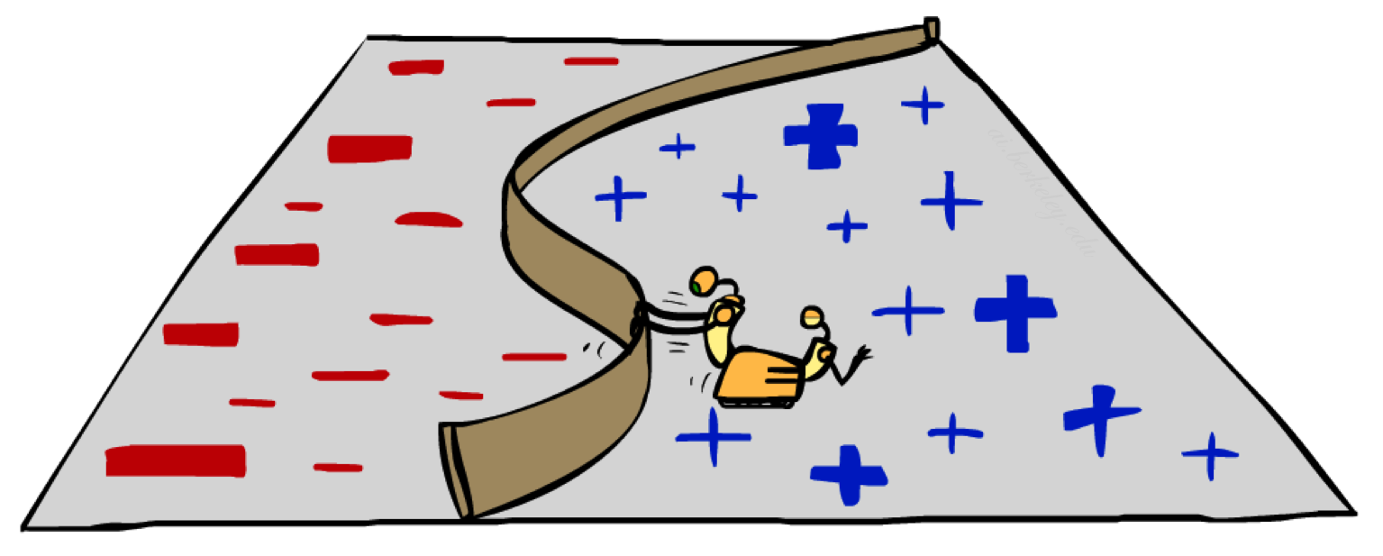
Non-Linearity

Slide 23
Non-Linear Separators
Data that is linearly separable works out great for linear decision rules:
But what are we going to do if the dataset is just too hard?
How about… mapping data to a higher-dimensional space:
0
x
0
x
x²
0
x
This and next few slides adapted from Ray Mooney, UT

Slide 24
Non-Linear Separators
General idea: the original feature space can always be mapped to some higher-dimensional feature space where the training set is separable:
Φ: x → φ(x)

Slide 25
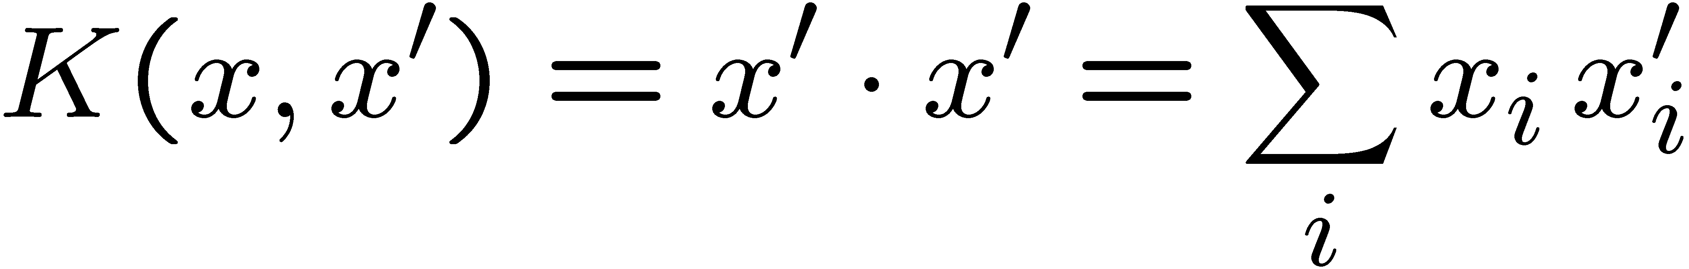
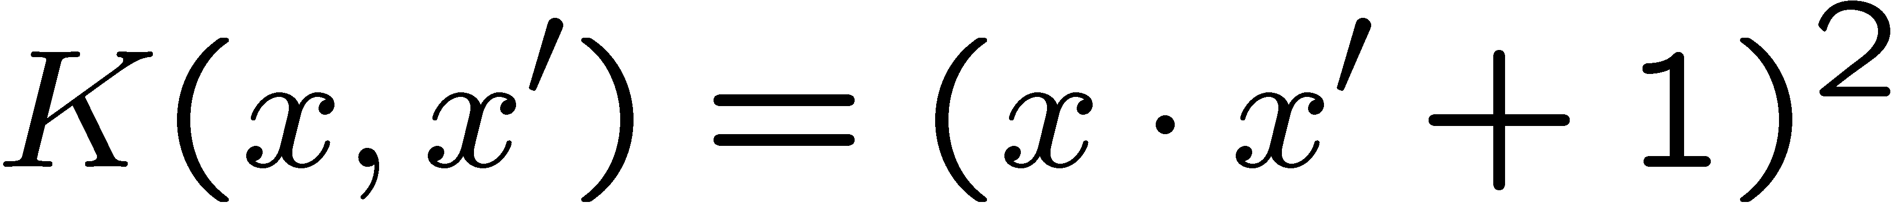
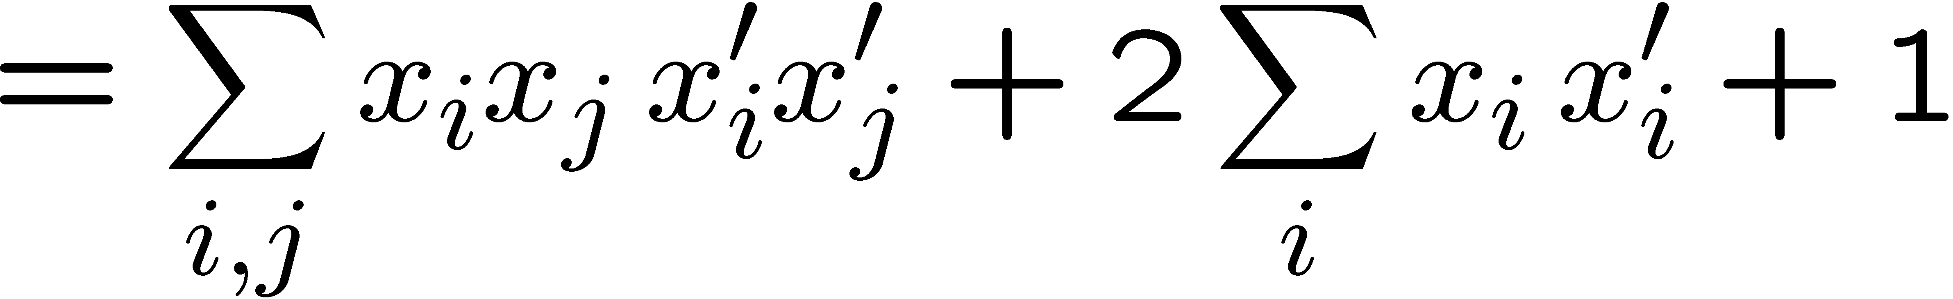
Some Kernels
Kernels implicitly map original vectors to higher dimensional spaces, take the dot product there, and hand the result back
Linear kernel:
Quadratic kernel:
RBF: infinite dimensional representation
Discrete kernels: e.g. string kernels

Slide 26
Why Kernels?
Can’t you just add these features on your own (e.g. add all pairs of features instead of using the quadratic kernel)?
Yes, in principle, just compute them
No need to modify any algorithms
But, number of features can get large (or infinite)
Some kernels not as usefully thought of in their expanded representation, e.g. RBF kernels
Kernels let us compute with these features implicitly
Example: implicit dot product in quadratic kernel takes much less space and time per dot product
Of course, there’s the cost for using the pure dual algorithms: you need to compute the similarity to every training datum

Slide 27
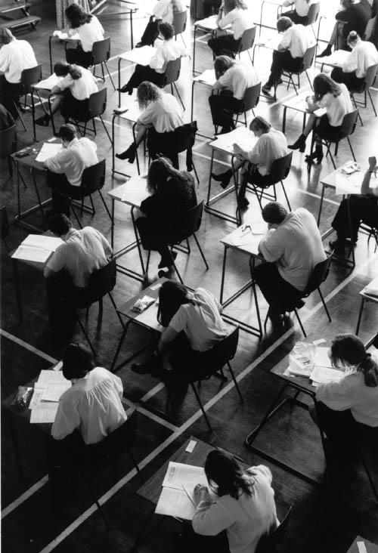
Recap: Classification
Classification systems:
Supervised learning
Make a prediction given evidence
We’ve seen several methods for this
Useful when you have labeled data

Slide 28
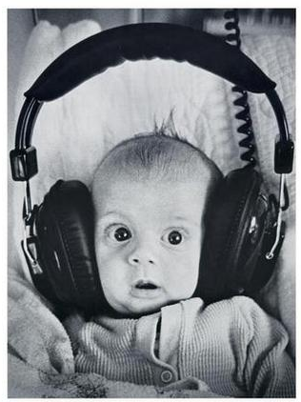
Clustering
Clustering systems:
Unsupervised learning
Detect patterns in unlabeled data
E.g. group emails or search results
E.g. find categories of customers
E.g. detect anomalous program executions
Useful when don’t know what you’re looking for
Requires data, but no labels
Often get gibberish

Slide 29
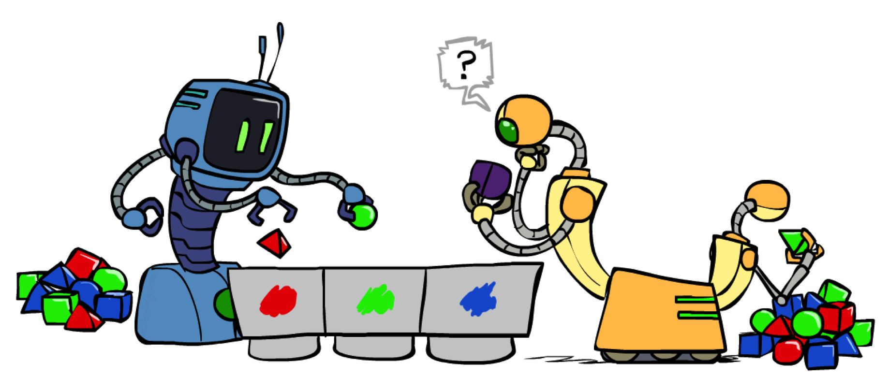
Clustering

Slide 30
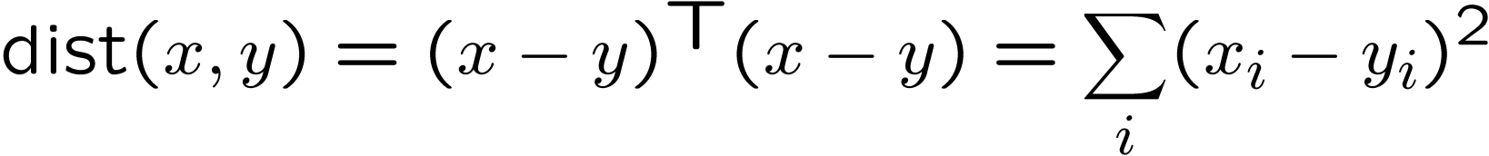
Clustering
Basic idea: group together similar instances
Example: 2D point patterns
What could “similar” mean?
One option: small (squared) Euclidean distance

Slide 31
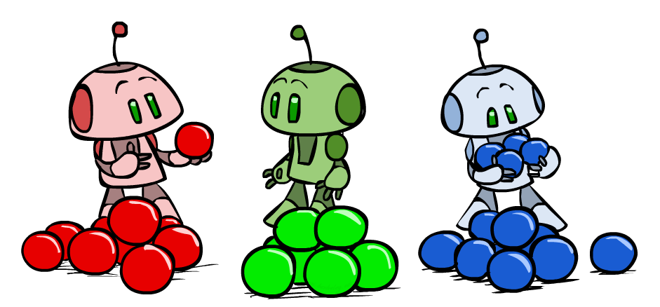
K-Means

Slide 32
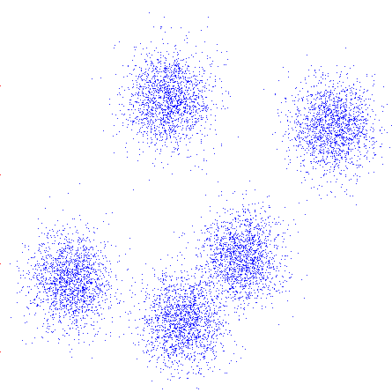
K-Means
An iterative clustering algorithm
Pick K random points as cluster centers (means)
Alternate:
Assign data instances to closest mean
Assign each mean to the average of its assigned points
Stop when no points’ assignments change

Slide 33
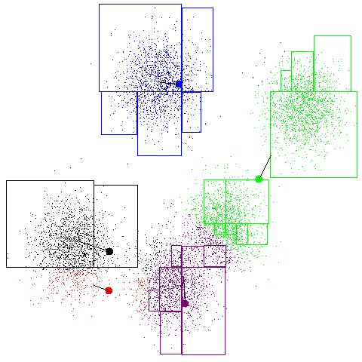
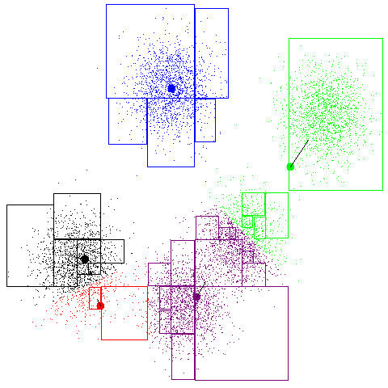
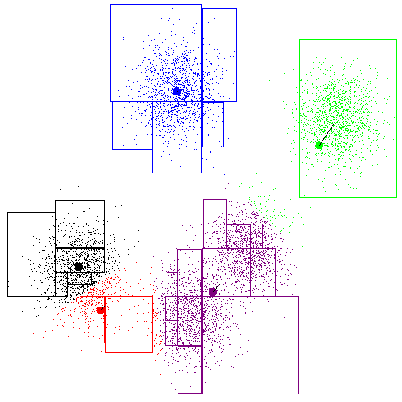
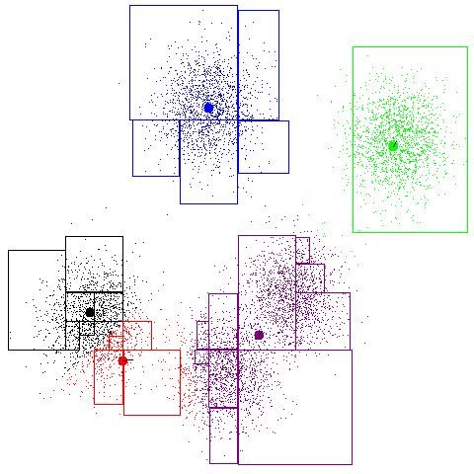
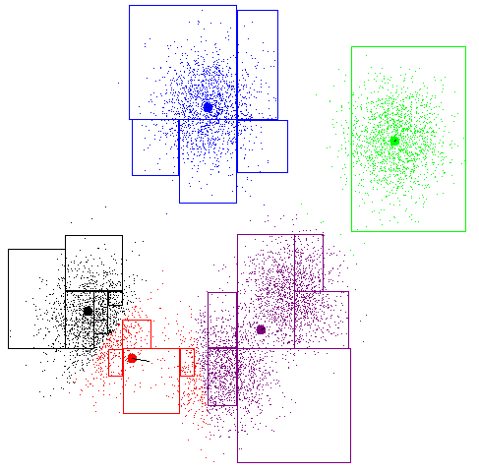
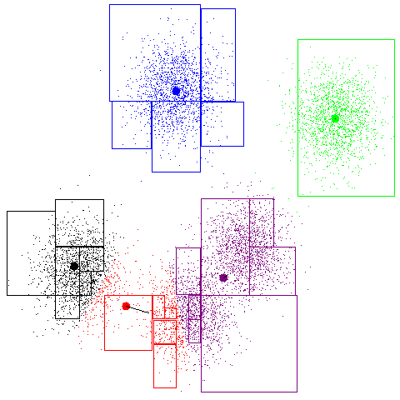
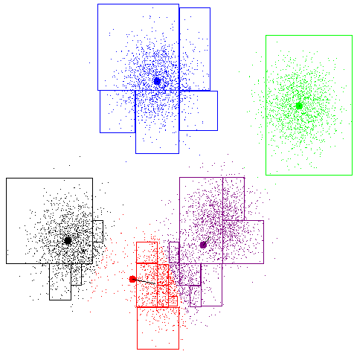
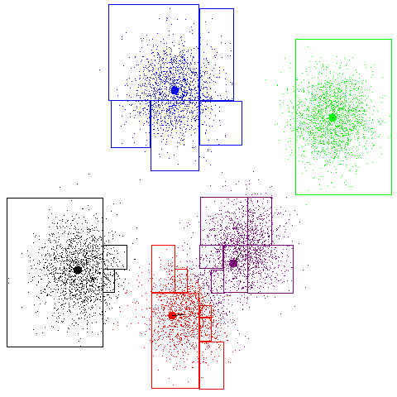
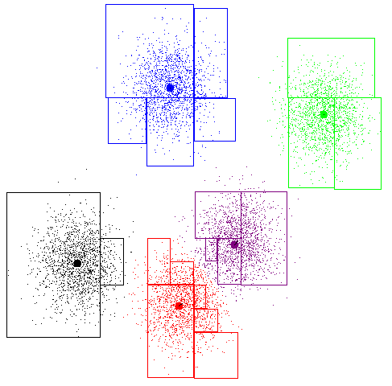
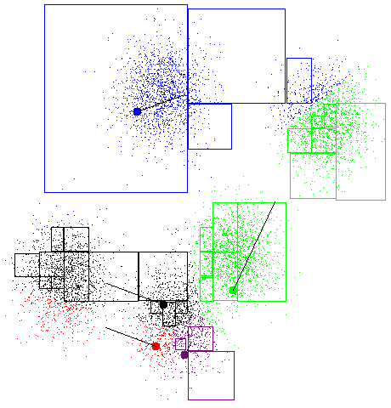
K-Means Example

Slide 34
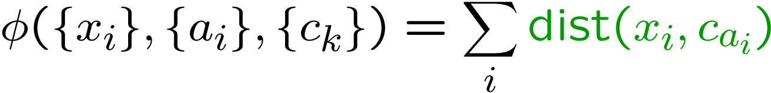
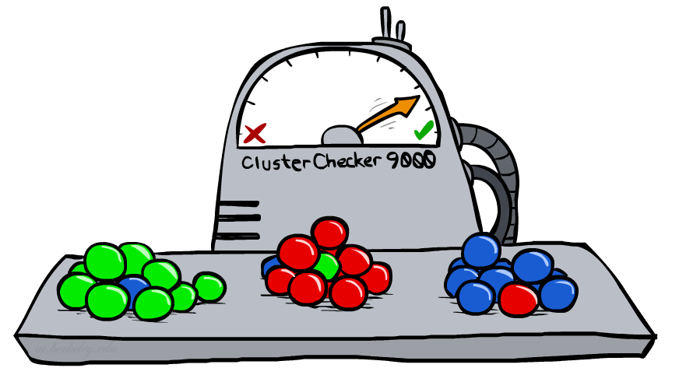
K-Means as Optimization
Consider the total distance to the means:
Each iteration reduces phi
Two stages each iteration:
Update assignments: fix means c, change assignments a
Update means: fix assignments a, change means c
points
means
assignments

Slide 35
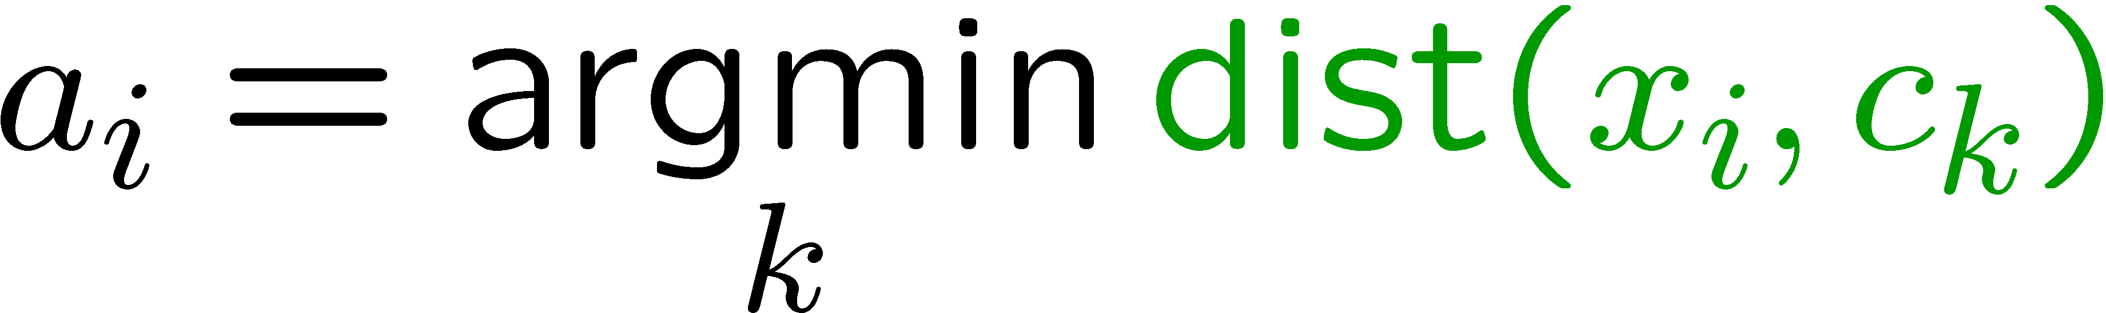
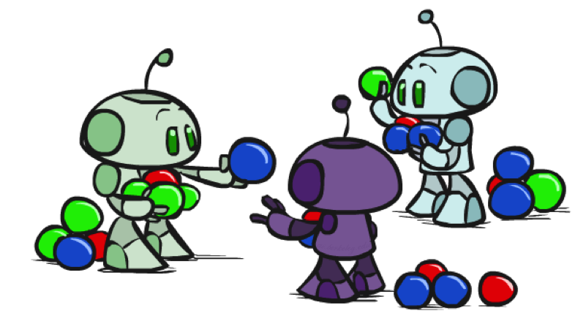


Phase I: Update Assignments
For each point, re-assign to closest mean:
Can only decrease total distance phi!

Slide 36


Phase II: Update Means
Move each mean to the average of its assigned points:
Also can only decrease total distance… (Why?)
Fun fact: the point y with minimum squared Euclidean distance to a set of points {x} is their mean

Slide 37

Initialization
K-means is non-deterministic
Requires initial means
It does matter what you pick!
What can go wrong?
Various schemes for preventing this kind of thing: variance-based split / merge, initialization heuristics

Slide 38

K-Means Getting Stuck
A local optimum:
Why doesn’t this work out like the earlier example, with the purple taking over half the blue?

Slide 39

K-Means Questions
Will K-means converge?
To a global optimum?
Will it always find the true patterns in the data?
If the patterns are very very clear?
Will it find something interesting?
Do people ever use it?
How many clusters to pick?

Slide 40

Agglomerative Clustering

Slide 41
Agglomerative Clustering
Agglomerative clustering:
First merge very similar instances
Incrementally build larger clusters out of smaller clusters
Algorithm:
Maintain a set of clusters
Initially, each instance in its own cluster
Repeat:
Pick the two closest clusters
Merge them into a new cluster
Stop when there’s only one cluster left
Produces not one clustering, but a family of clusterings represented by a dendrogram

Slide 42
Agglomerative Clustering
How should we define “closest” for clusters with multiple elements?
Many options
Closest pair (single-link clustering)
Farthest pair (complete-link clustering)
Average of all pairs
Ward’s method (min variance, like k-means)
Different choices create different clustering behaviors

Slide 43

Example: Google News
Top-level categories: supervised classification
Story groupings:
unsupervised clustering

Slide 44
Example: K-Means
[web demo]
http://www.cs.washington.edu/research/imagedatabase/demo/kmcluster/

Slide 45
Next Time: Advanced Applications!

